Slide 1
Information Visualization Visualization Sketch
G08-A
70969 – Mário Reis
75456 – Artur Fonseca
76046 – André Pires

Slide 2
Visual encoding
01

Slide 3
Visual Encoding
Course Unemployment %
Encoded as position in vertical axis
Year
Encoded as position in horizontal axis

Slide 4
Visual Encoding
Course/University Name
Encoded as colours “hue”
Entry Grade
Encoded as position in horizontal axis

Slide 5
IDIOM – tasks/questions mapping
02

Slide 6
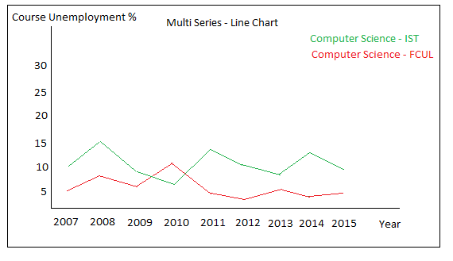
Task 1
Compare the unemployment (%) of different courses (regardless of course conclusion year of the graduates) - Query->Compare
Question 1: Does Computer Science graduates in IST have more unemployment, in 2015, than Computer Science in FCUL? And in 2007?
Due to interaction we can add more courses to the line chart and compare them.

Slide 7
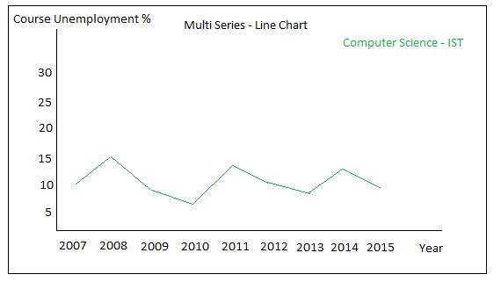
Task 2
Present the information about unemployment (%) from a specific course graduates across time - Analyze->Consume->Present
Question 2: Is Computer Science in IST having less unemployed graduates in last year’s? Is Computer Science in IST having less unemployed graduates in last year’s?
Question 3: What was the year which had less unemployed people from Computer Science in IST?
Line chart presenting unemployment of one course

Slide 8
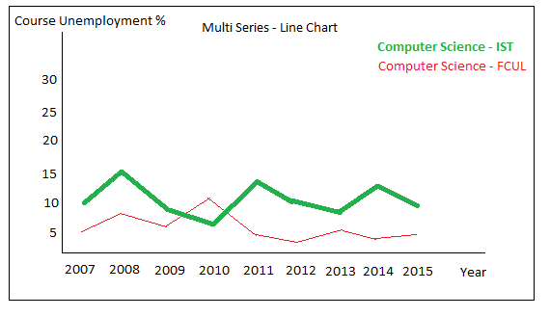
Task 1 & 2
It’s possible to select a course line and highlight the course in the other views ex: Highlight the course dot in the next presented idiom

Slide 9
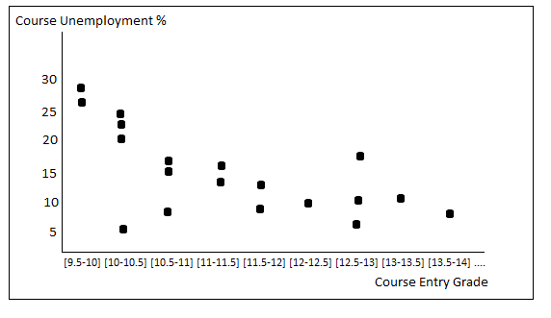
Task 4
Relation between minimum entry grade and unemployment (%) - Consume->Present
Question 4: Where the unemployment will be higher? In a course with 14 minimum entry grade or one with 17?

